Slide 1

Mnemonic Similarity
Objects (Continuous)

Slide 2
I am going to test your memory by showing you a series of objects. For each object, you need to indicate if the item is OLD (V) or NEW (N).
OLD refers to exactly the same picture that you saw earlier. NEW refers to an item that you have not seen within the context of the experiment. Some of the items may be similar to ones you’ve seen before. But if it’s not the same exact picture, call it NEW.
Before you begin, I am going to show you a brief demonstration to give you a feel for the task.

Slide 3
What’s in the box below is what you’d be seeing on the screen. For now, we’ll keep track of these along the bottom, but you won’t see that during the task. That’s what you’re going to keep in your memory.
Memory:

Slide 4
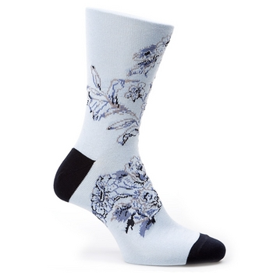
“New” (n)
Memory:

Slide 5

“New” (n)
Memory:

Slide 6
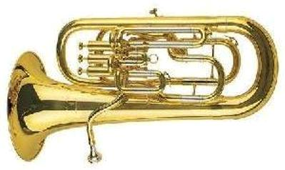
“New” (n)
Memory:

Slide 7
“Old” (v)
Memory:

Slide 8
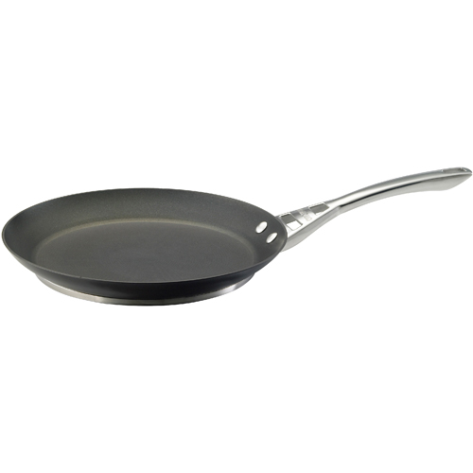
“New” (n)
Memory:

Slide 9
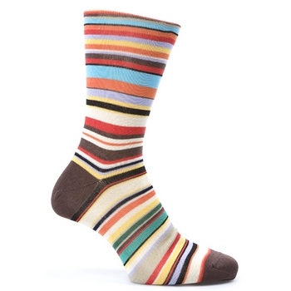
“New” (n)
Memory:

Slide 10
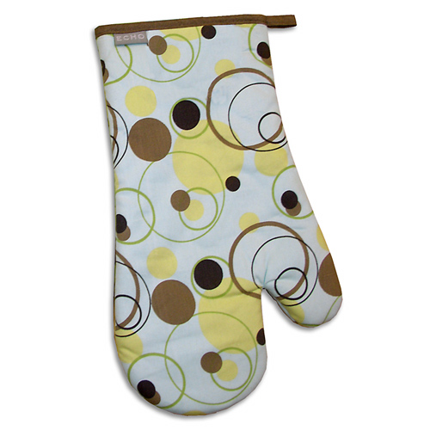
“New” (n)
Memory:

Slide 11
“Old” (v)
Memory:

Slide 12
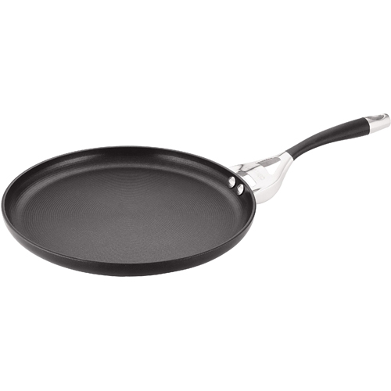
“New” (n)
Memory:

Slide 14
Now it’s your turn.
For each item, you need to indicate if the item is
OLD (V) or NEW (N).

